Slide 1
Frozen Lake & Q-Learning
explanation of the frozen lake game as a Reinforcement learning, practical learning of Q-learning with frozen lake
Nimra Amer 21L-5609
Muhammad Ahmad 21L-5617

Slide 2
Table of contents
01
02
03
What is RL
Game Overview
What is Q-Learning?
04
05
06
How It Works
Prototype
Conclusion

Slide 3
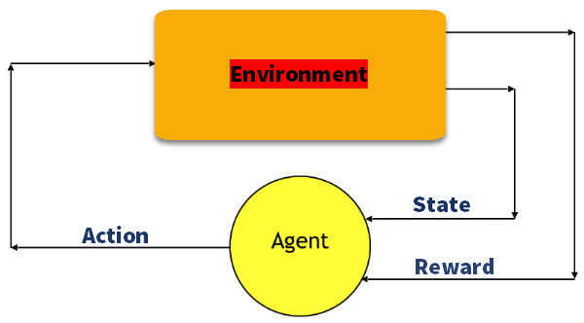
01
Reinforcement Learning

Slide 4
What is RL?
The agent learns by interacting with the environment.
Goal: Maximize cumulative rewards.
Key terms:
State: Environment representation.
Action: Choices for the agent.
Reward: Feedback for actions.

Slide 5
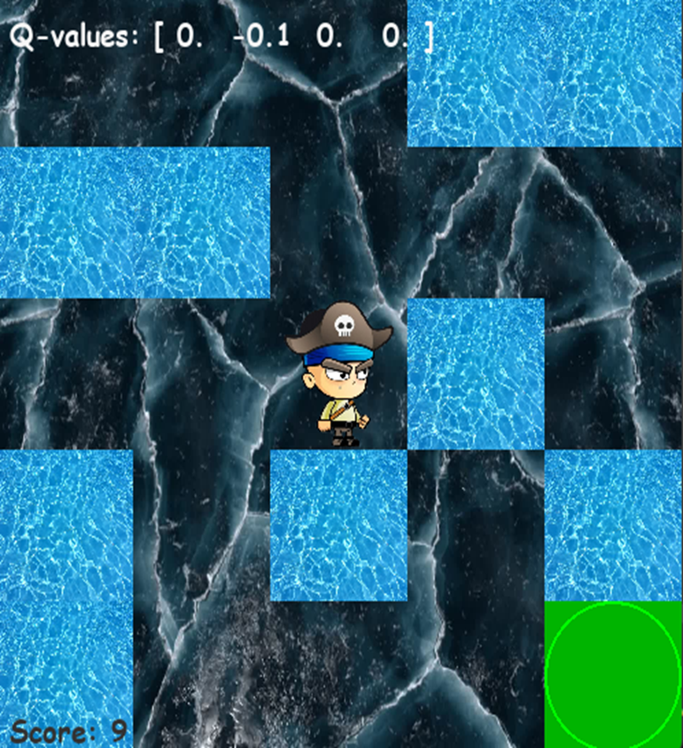
02
Game Overview

Slide 6
Game Overview
Grid with a frozen surface.
Objective: Move to the goal without falling into holes.
Actions: Left, Right, Up, Down.
Challenges: Slippery tiles add randomness.

Slide 7
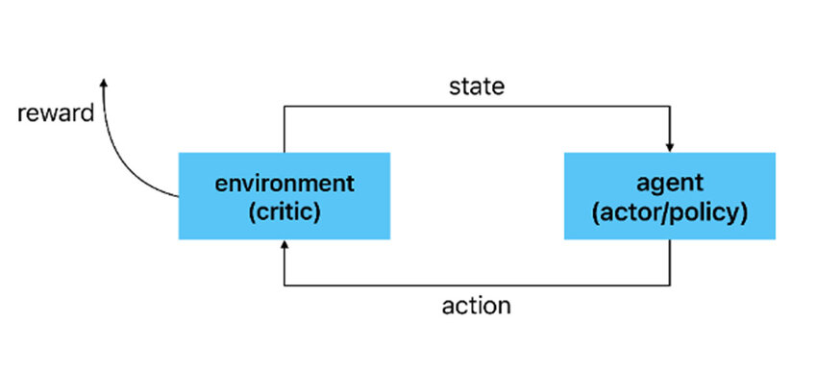
03
Q-Learning

Slide 8
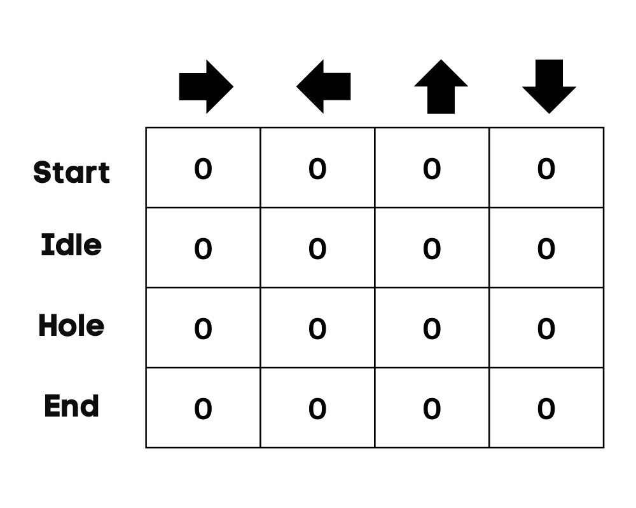
What is Q-Learning?
An RL algorithm to learn optimal
actions. Updates a Q-table:
Rows = States
Columns = Actions

Slide 9
How It Works
Initialize the Q-table with zeros.
Choose actions using exploration (e.g., ε-greedy).
Update Q-values based on the formula.
Repeat until convergence.
Q(s,a)←Q(s,a)+α[r+γa′max​Q(s′,a′)−Q(s,a)]

Slide 10
05
Prototype

Slide 11

06
Conclusion

Slide 12
Conclusion
Q-Learning helps agents learn optimal strategies.
Frozen Lake is a great RL introduction.
Challenges: Handling randomness in actions.

